Slide 1
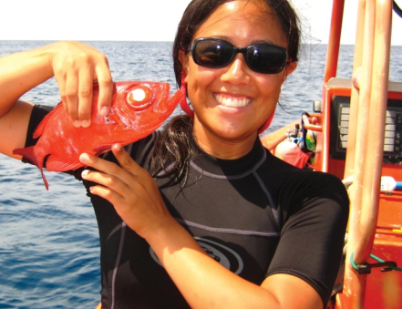
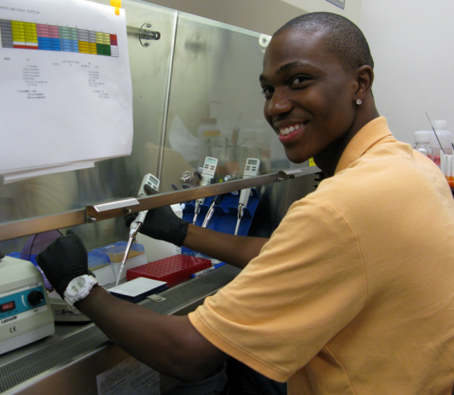
www.noaa.gov/students
STUDENT OPPORTUNITIES!!
www.noaa.gov/students
Undergraduate
Ernest F. Hollings Scholarship
EPP/MSI Scholarship
Woods Hole PEP
JUST A FEW!
Graduate
Sea Grant John A. Knauss Marine Policy Fellowship
Dr. Nancy Foster Scholarship
Coastal Management Fellowship
Notes:
One-stop shop for most NOAA opportunities
Get a handle on deadlines

Slide 2
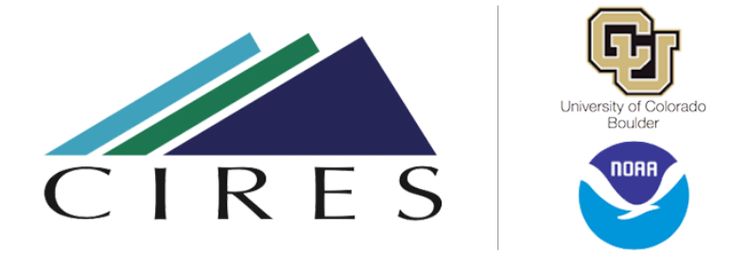
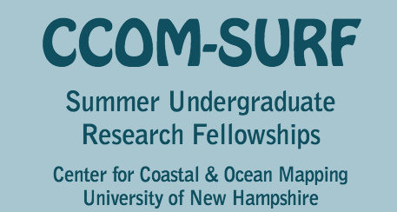
Summer Undergrad Research Fellowship in Oceanography (SURFO)
Summer Research Experiences for Undergrads (REU’s)
nsf.gov/crssprgm/reu/reu_search.jsp
web.uri.edu/gso/education/surfo/
Cooperative Institute for Research in Environmental Sciences (CIRES)
cires.colorado.edu
ccom.unh.edu/surf
Notes:
Additional OPPORTUNITIES
https://www.nsf.gov/crssprgm/reu/list_result.jsp?unitid=5053

Slide 3
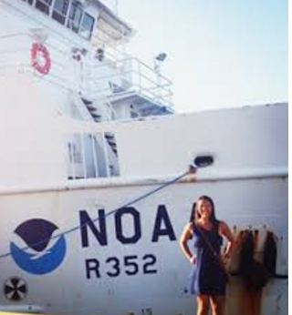
Internship Programs
coastalscience.noaa.gov/about/internship/overview/
Pathways Summer Interships
usajobs.gov/GetJob/ViewDetails/487986700
usajobs.gov/GetJob/ViewDetails/488005000

Slide 4
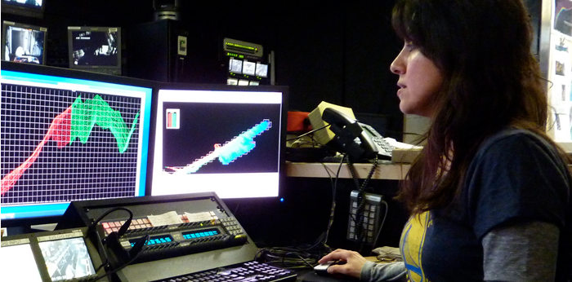
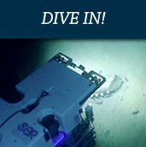
NOAA Ship Okeanos Explorer In Training Program
At Sea Opportunities
Joss.ucar.edu/okeanos-explorer-in-training-program
Ocean Exploration Trust E/V Nautilus Internship Program
E/V Nautilus Science & Engineering Internships
Oceanexplorationtrust.org

