Slide 1
Undergraduate Resources
NSF Research Experiences for Undergraduates:
https://www.nsf.gov/crssprgm/reu/reu_search.jsp
NOAA Hollings Scholarships:
https://www.noaa.gov/office-education/hollings-scholarship
Barry Goldwater Scholarship
https://goldwater.scholarsapply.org/

Slide 2
https://www.nsfgrfp.org/

Slide 3
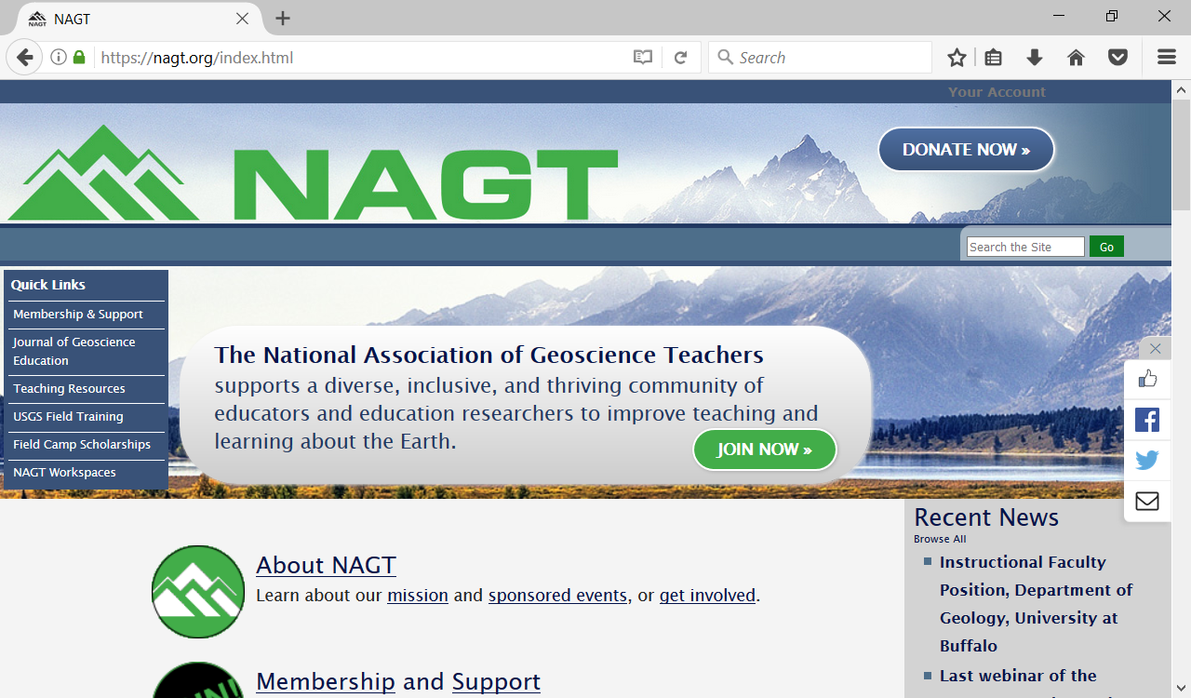
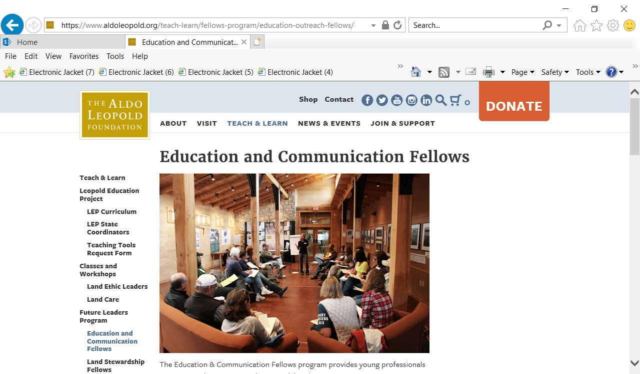
Professional Development Workshops
National Association of Geoscience Teachers
Aldo Leopold Foundation
American Geophysical Union Fellowships(AGU)

Slide 4
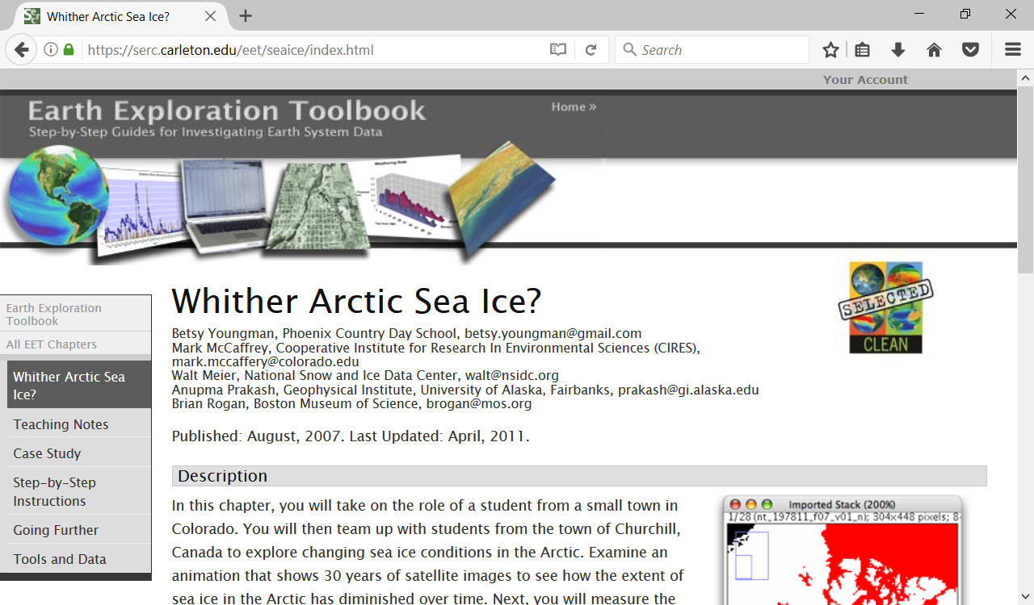
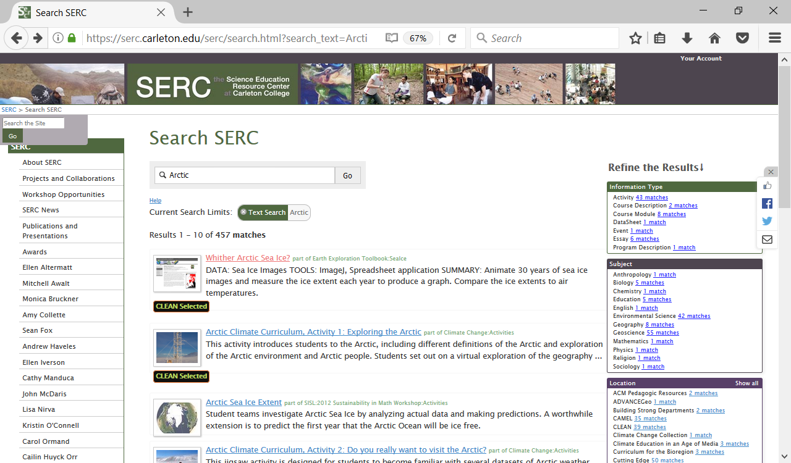
Science Education Resource Center – Carleton College
Teaching Resources that have been tested!

